Slide 1
Project 2
Darryl Bunn
Antonio Gomez
Robert Riggs
Jonathan Torres

Slide 2

What Categories see the most Sales?

Slide 3
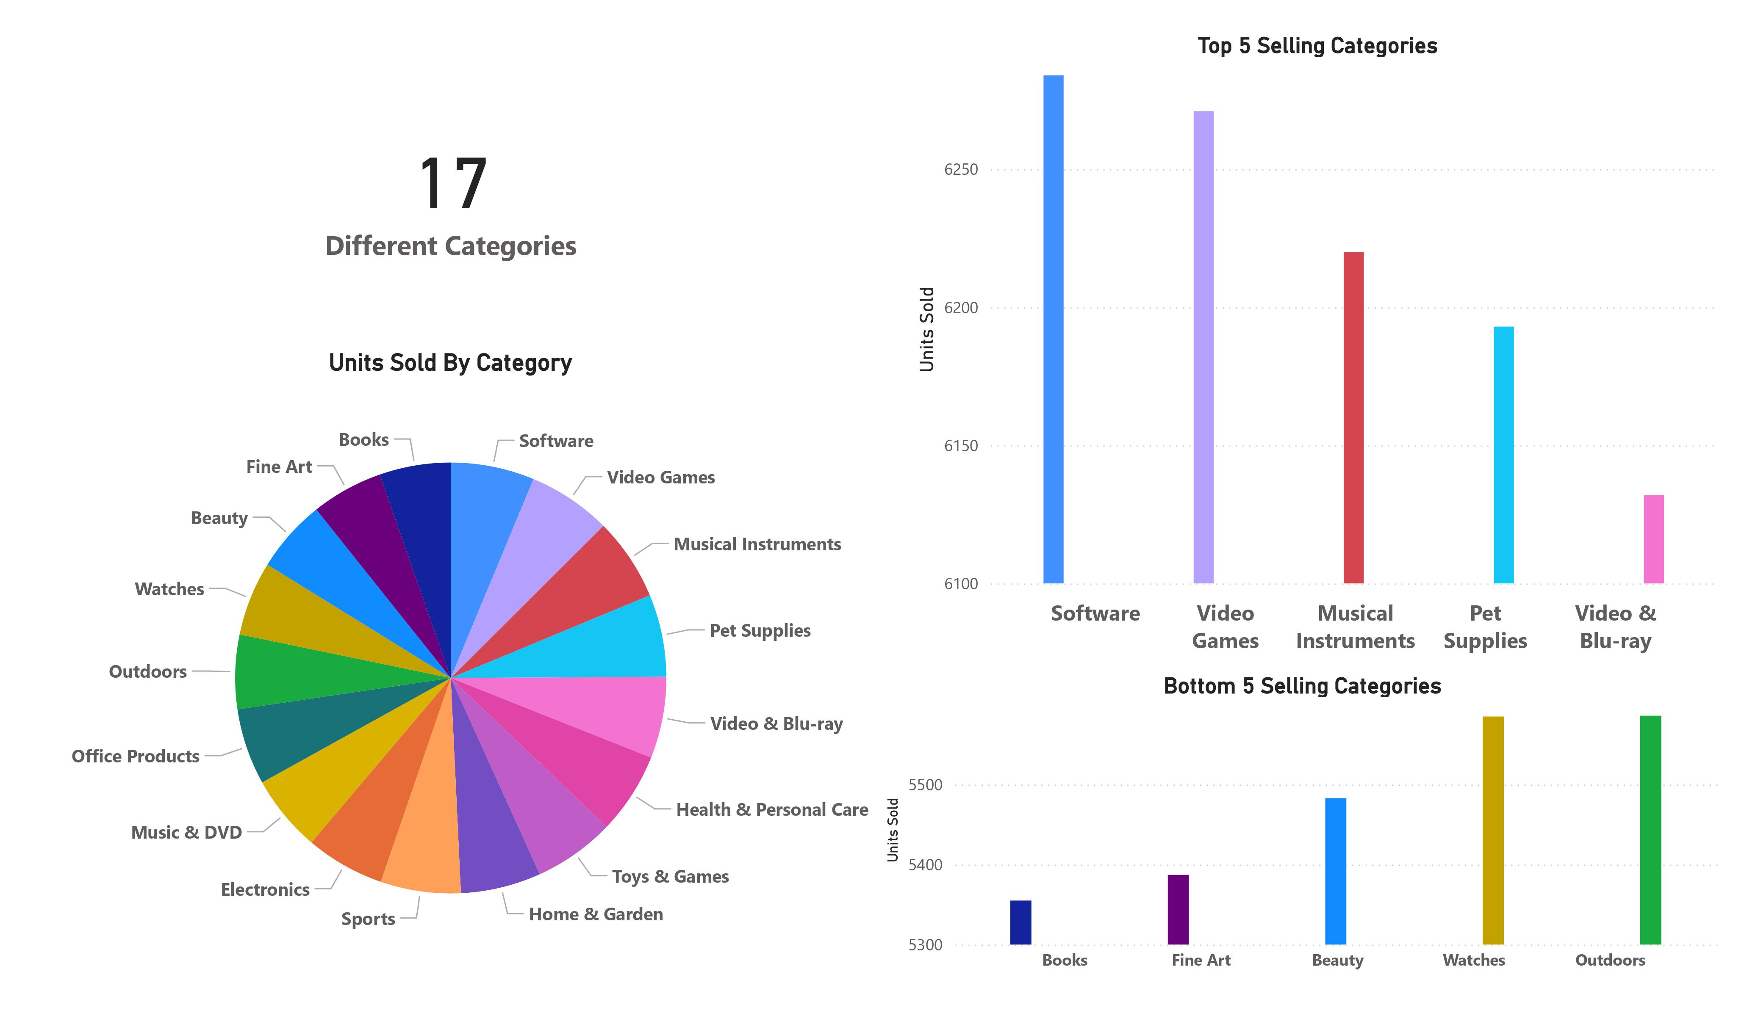

Slide 4
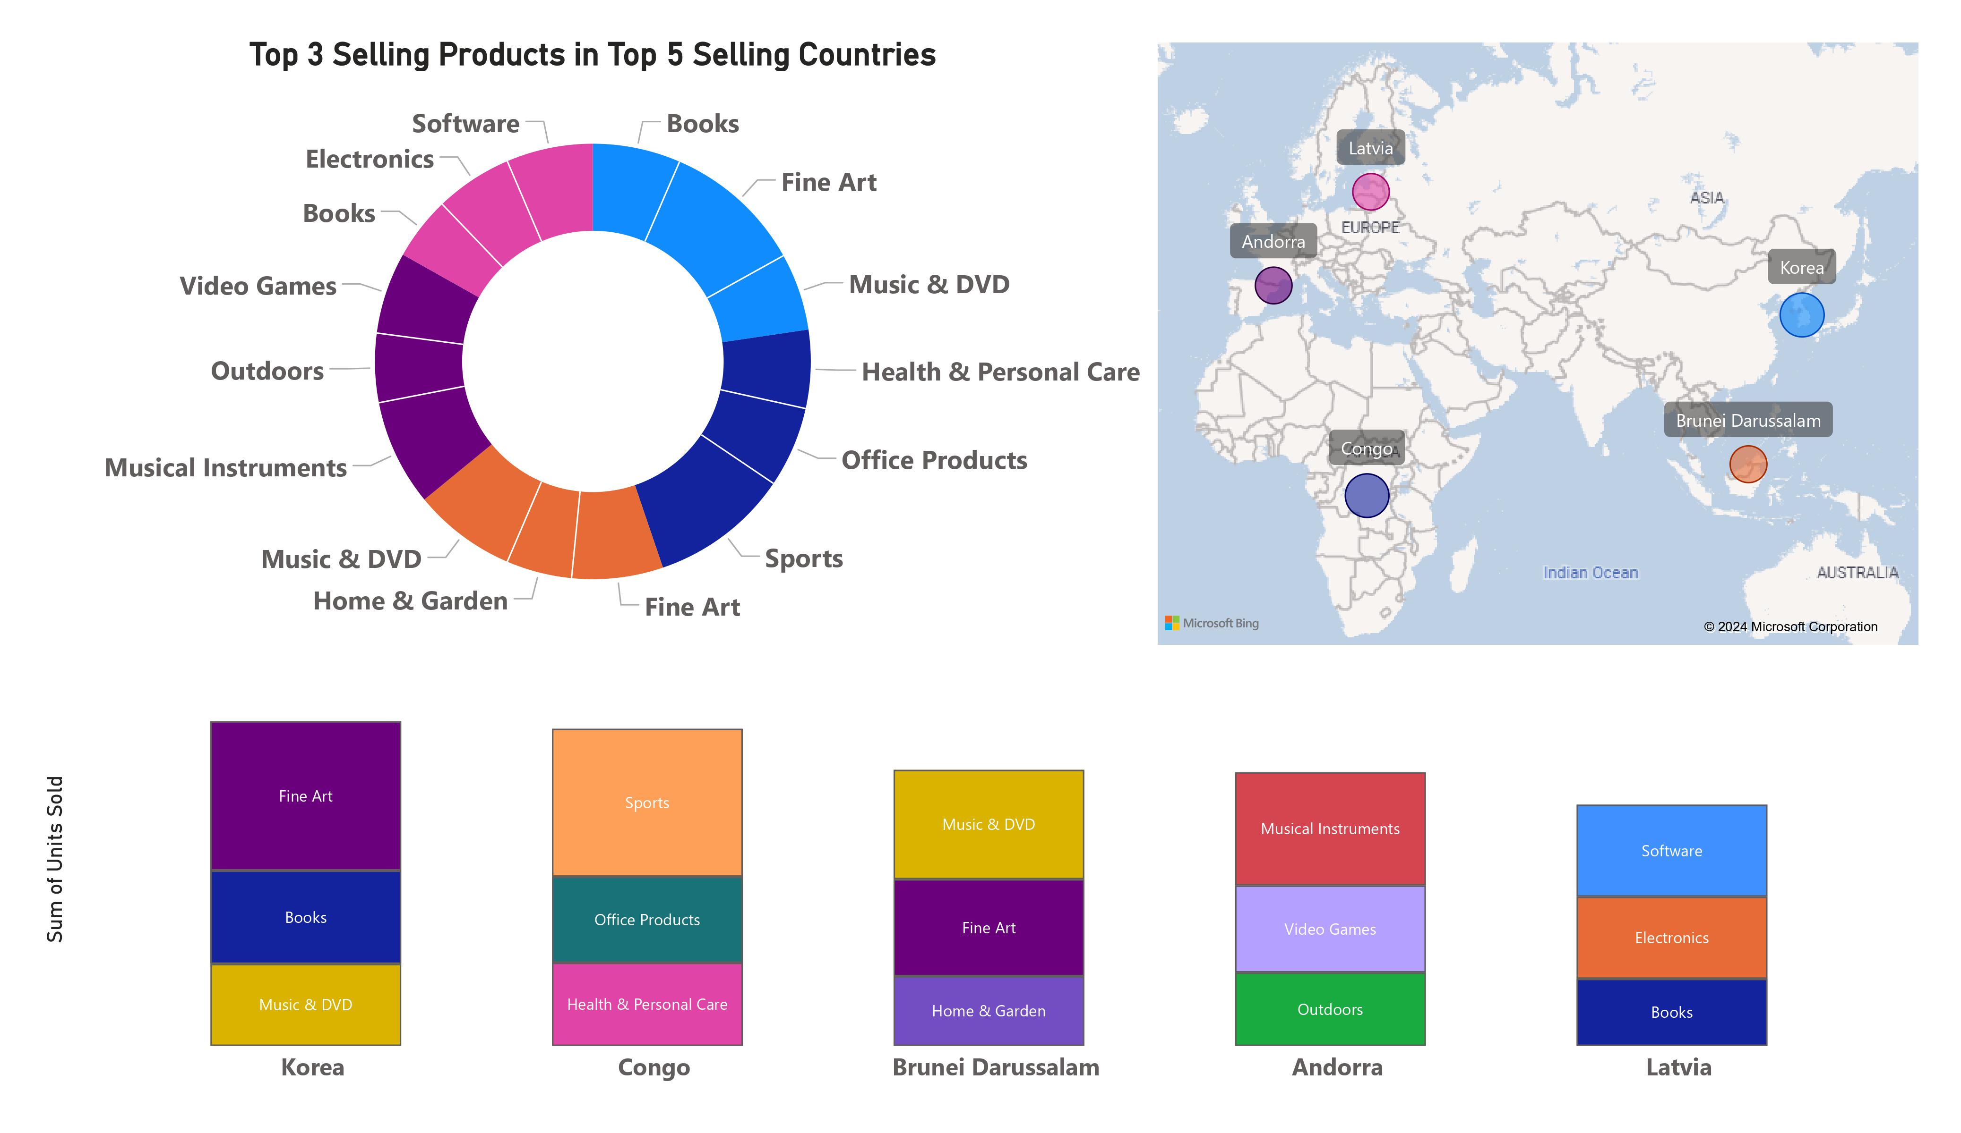

Slide 5
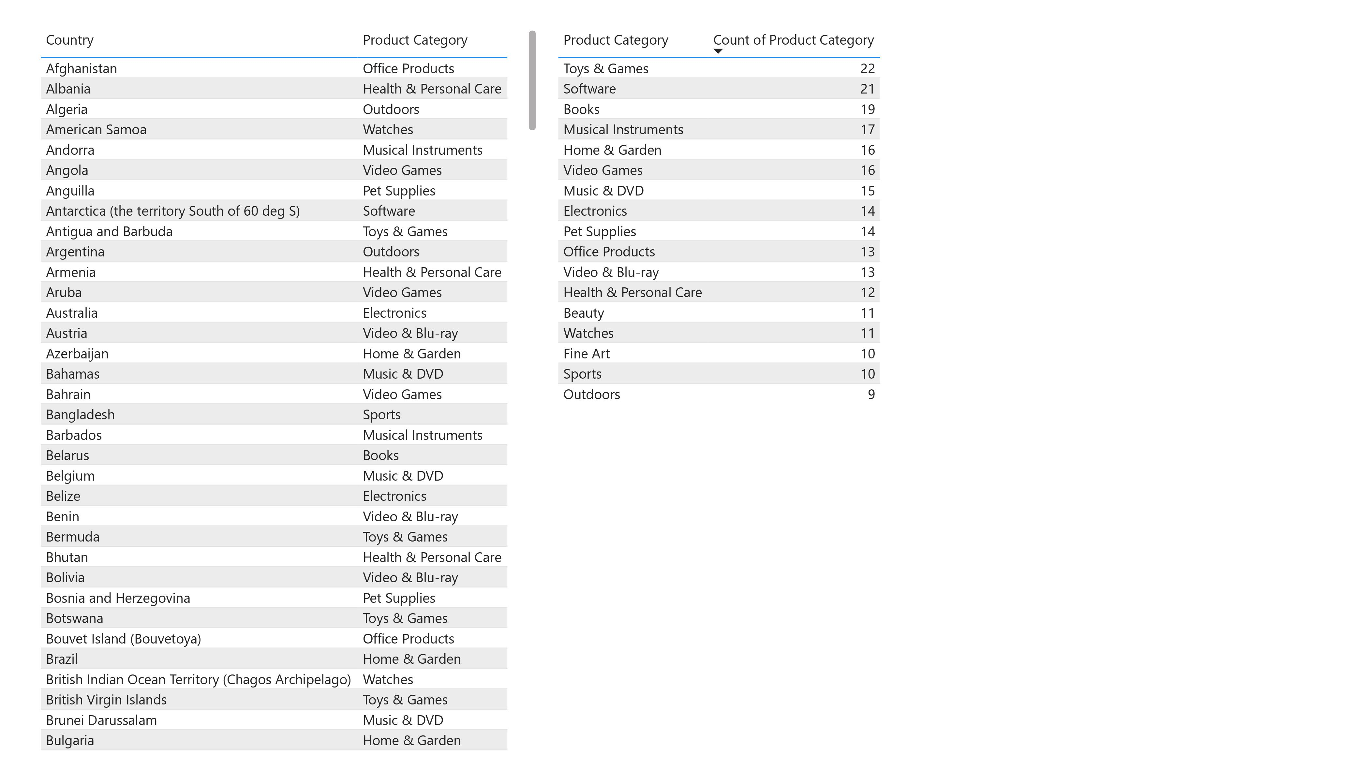

Slide 6
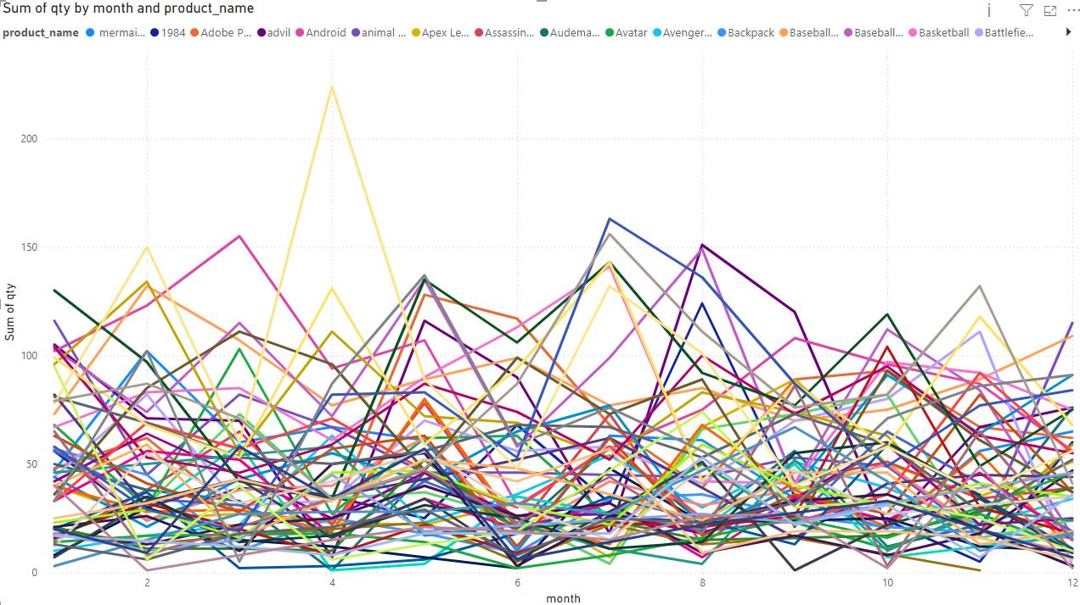
How does the popularity of products change throughout the year?

Slide 7
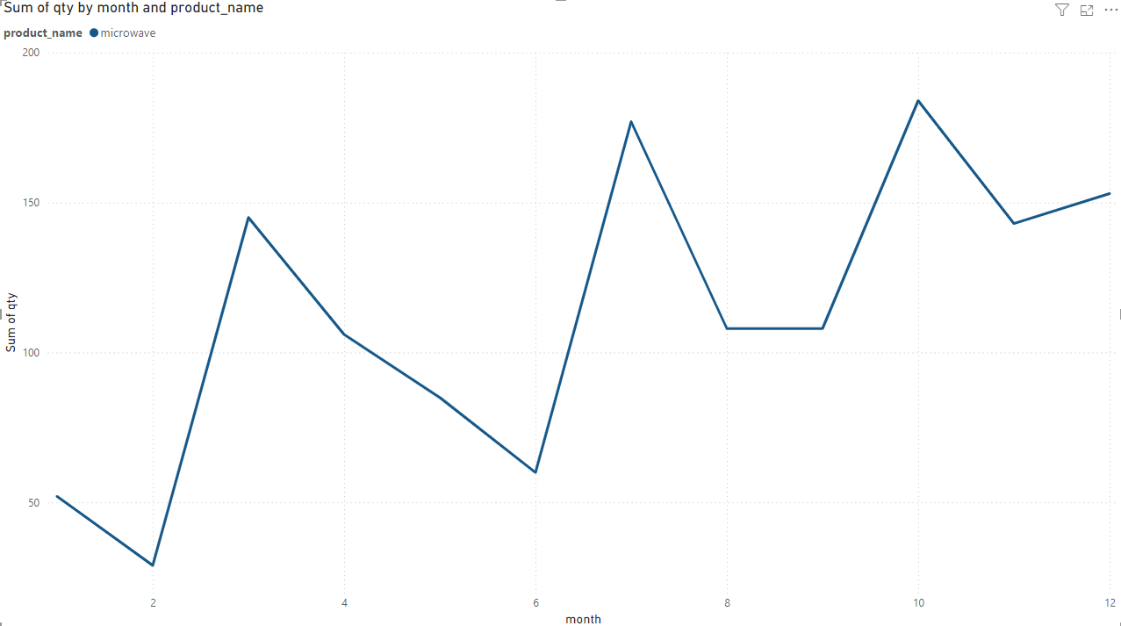
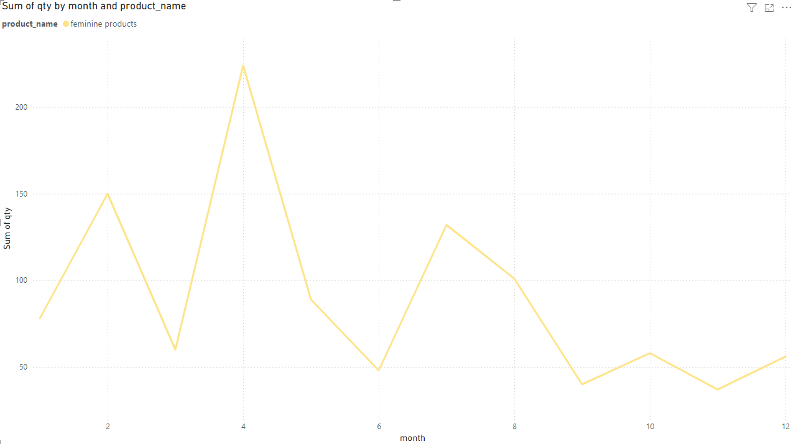
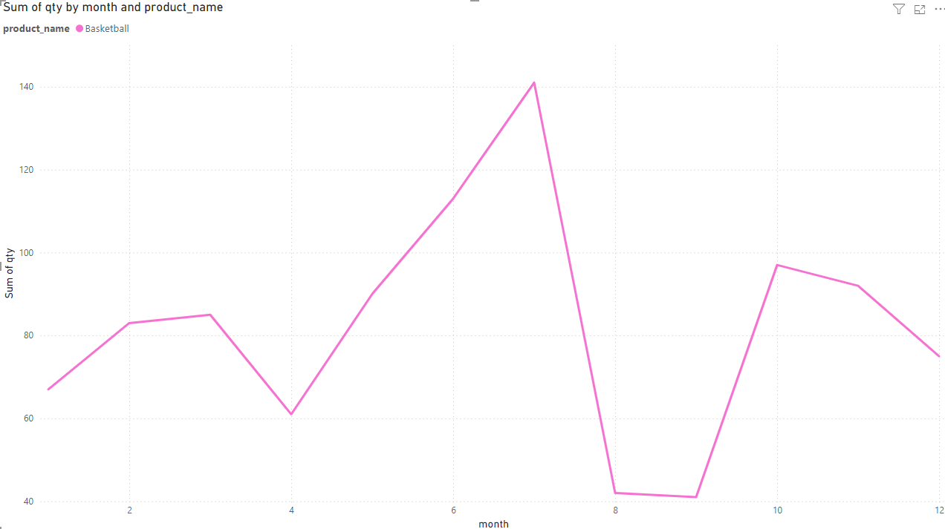
Examples of filtering by certain products

Slide 8
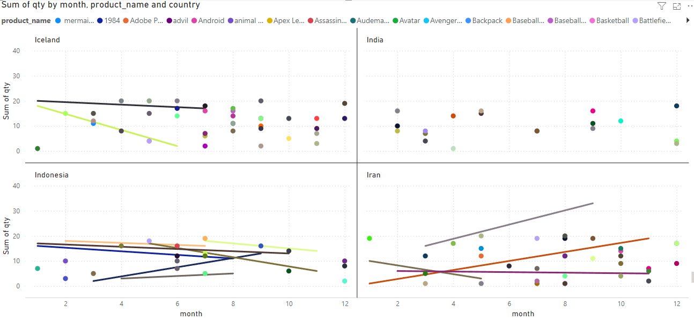
How does the popularity of products change throughout the year, per country?

Slide 9
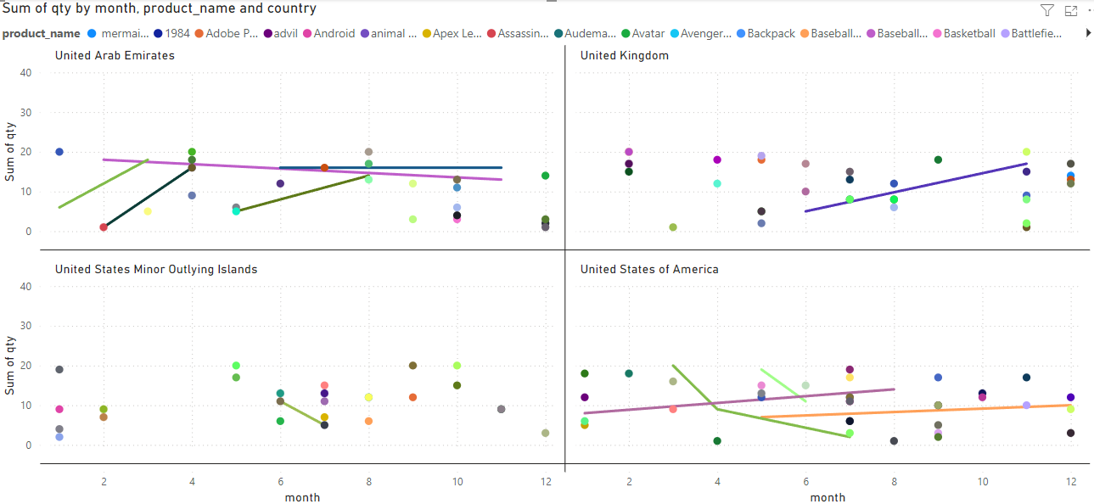

Slide 10
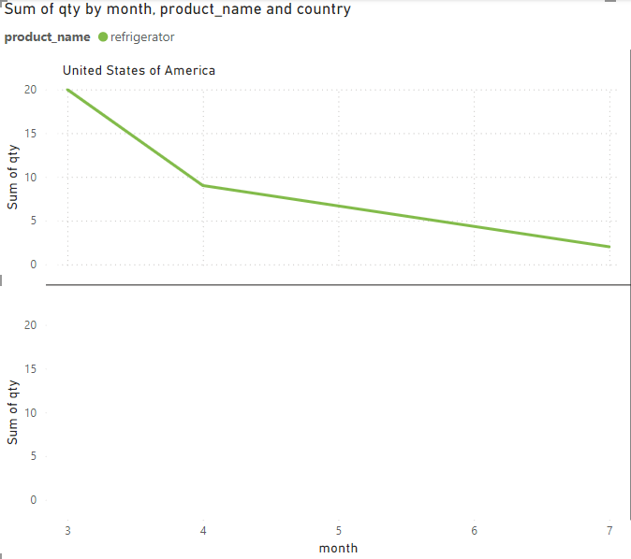
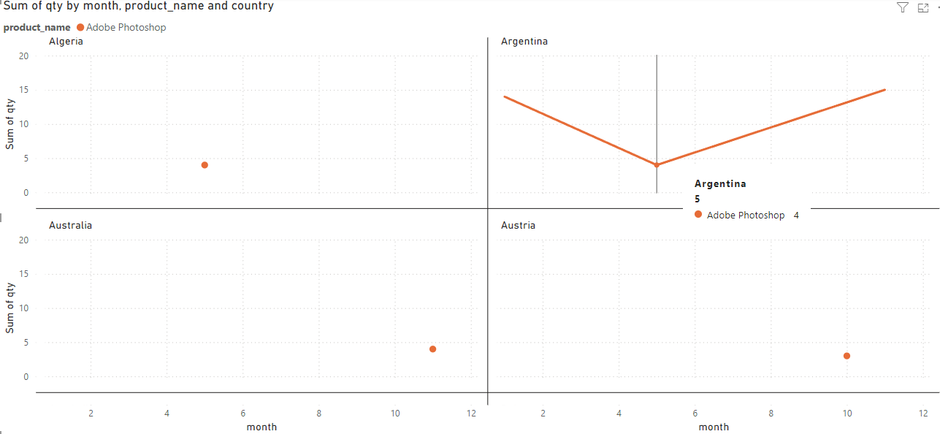
Example of filtering by a specific country and product
Example of filtering by a specific product

Slide 11

Which locations see the highest traffic of sales..

Slide 12
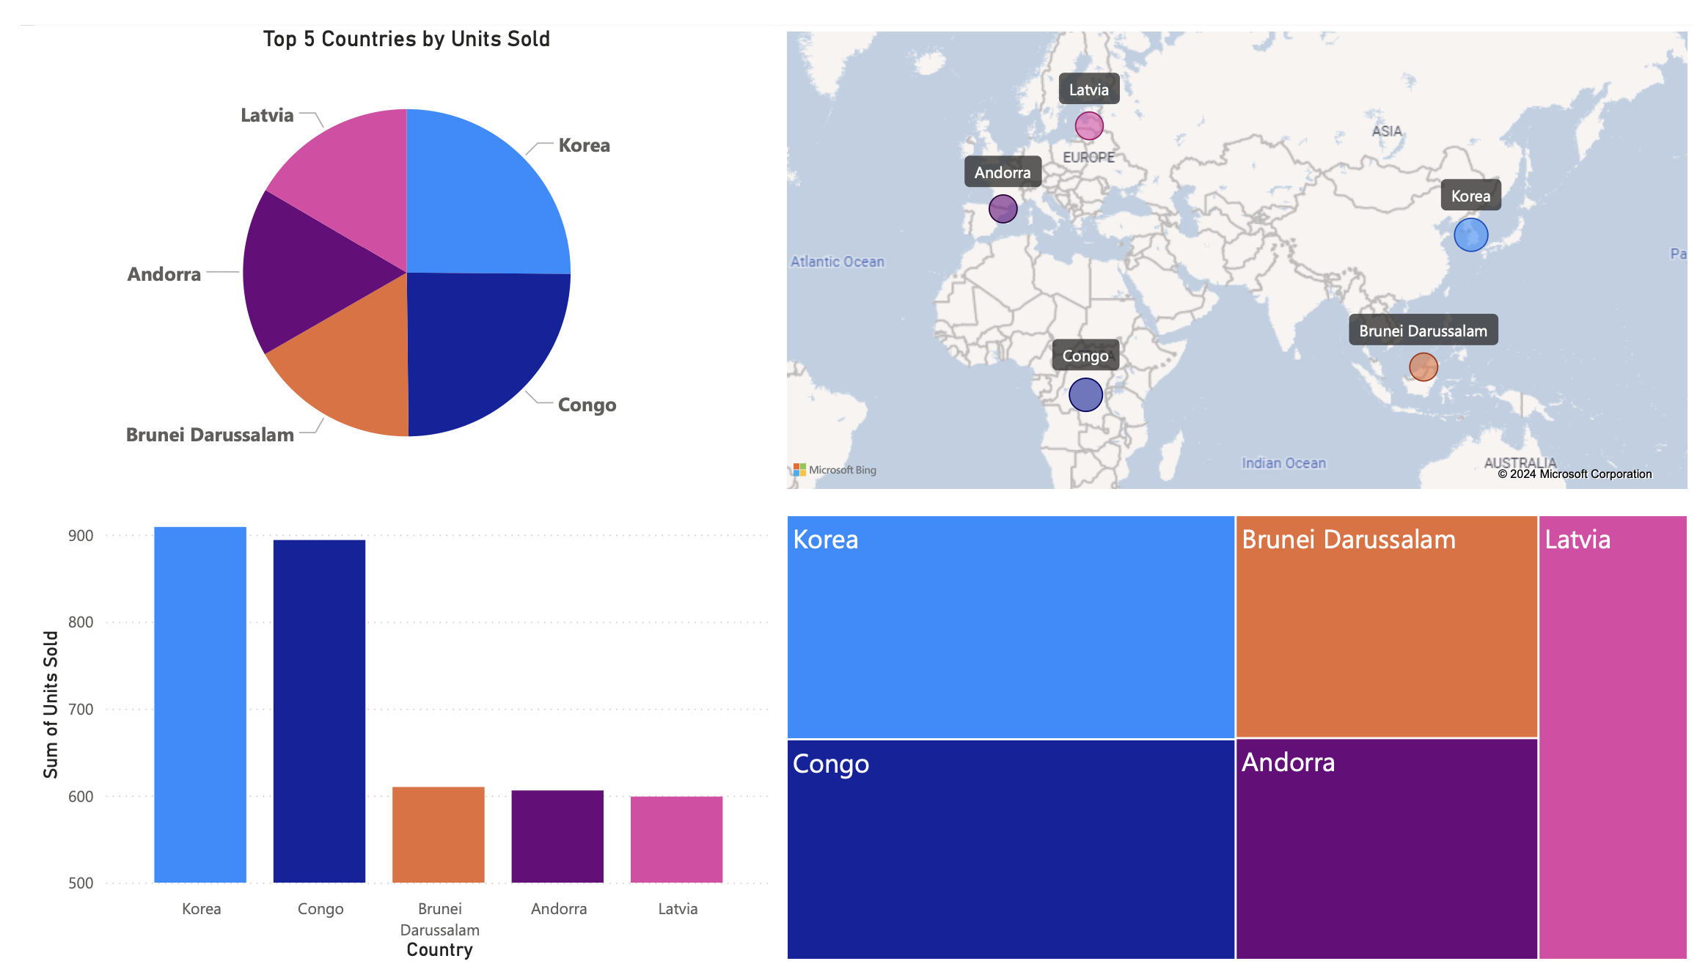

Slide 13
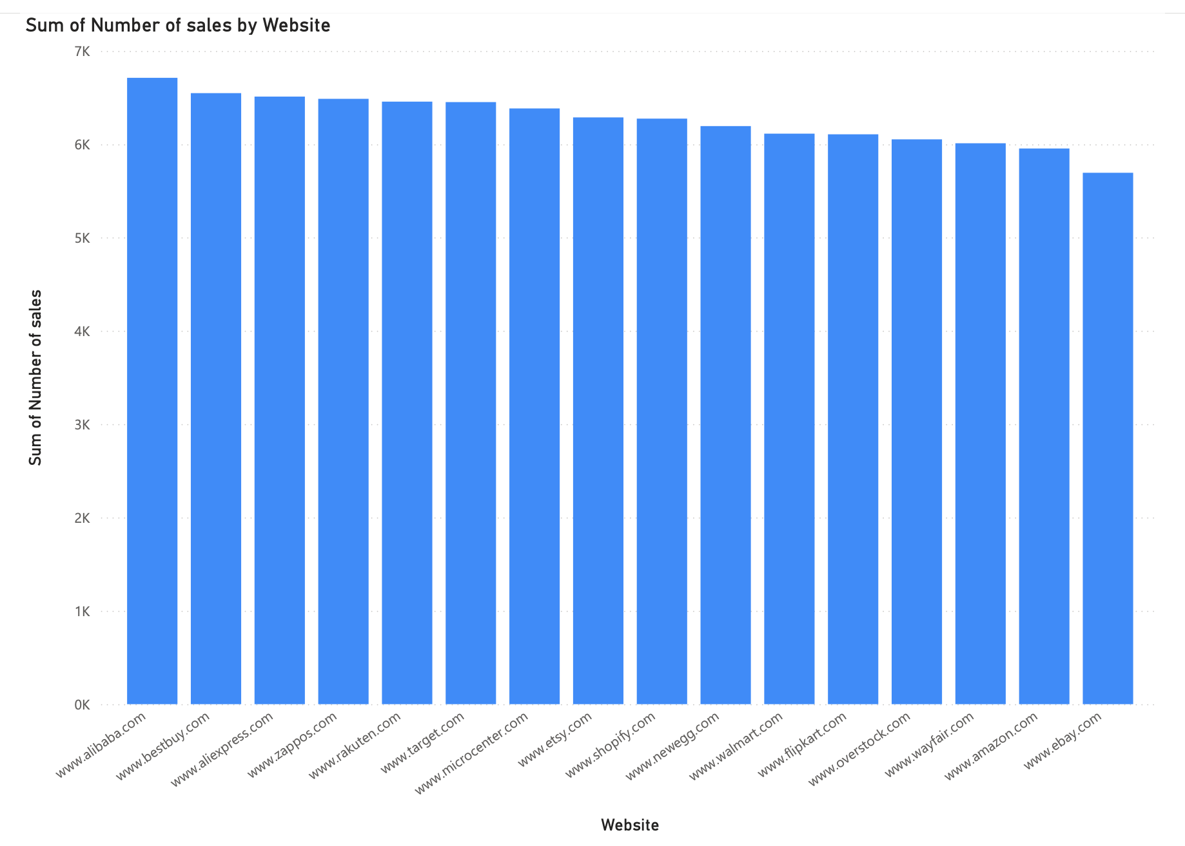
By website

Slide 14
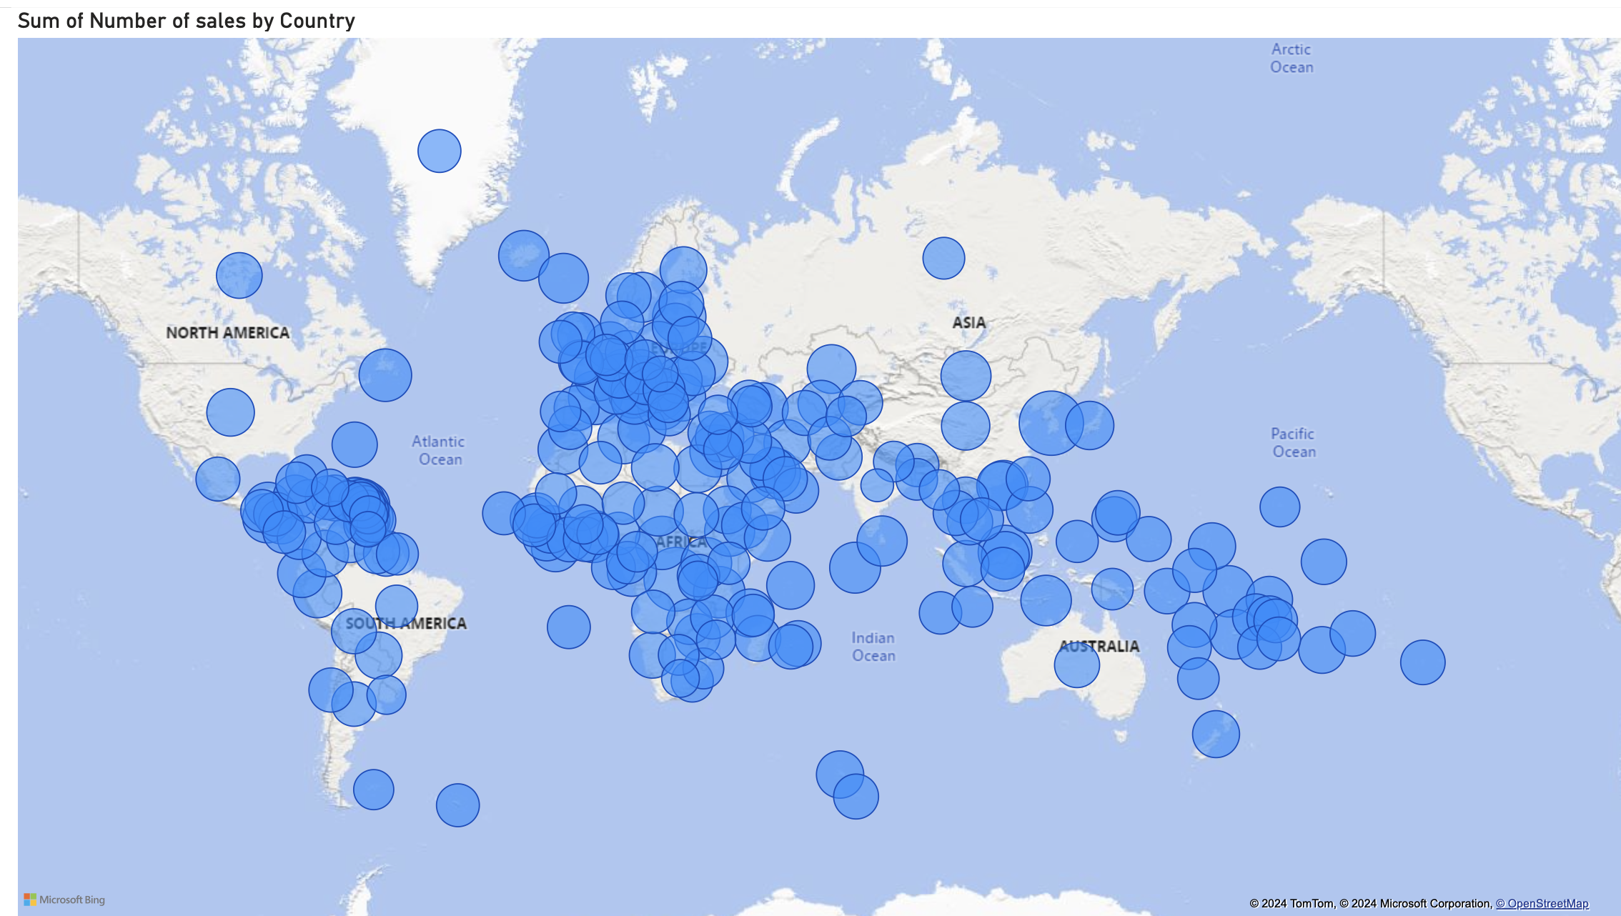
Number of sales by country

Slide 15
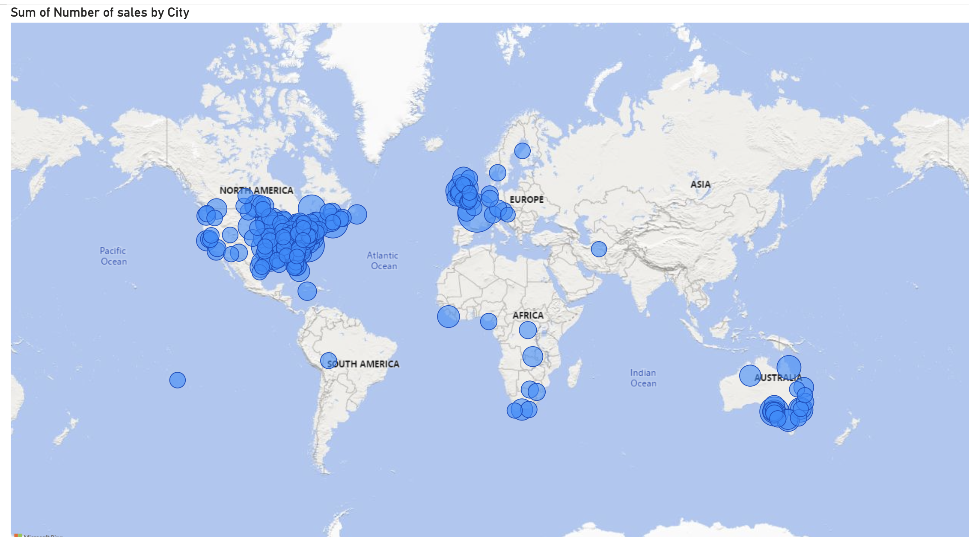
Number of sales by city

Slide 16
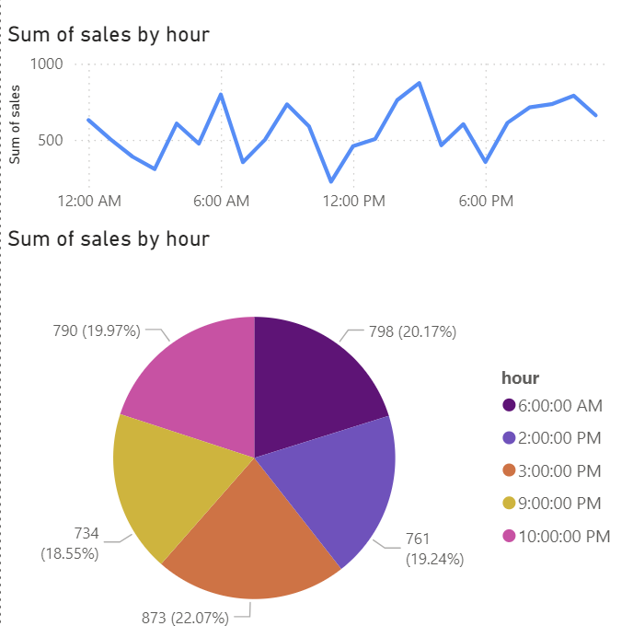

Slide 17
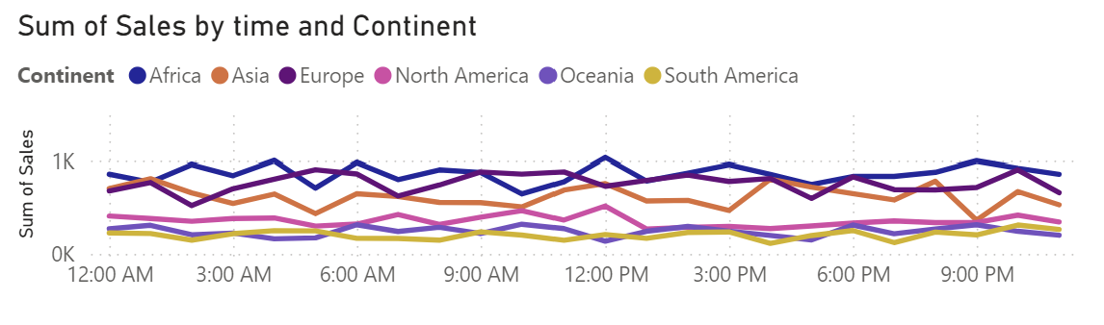

Slide 18
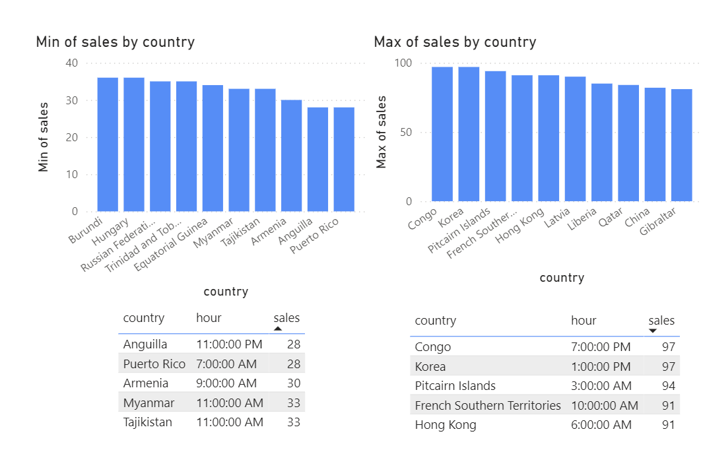

Slide 19

Observations
Since most of our sales occur in the middle/East countries, targeting those countries with marketing strategies can yield the greatest return based off geographical location.
While the most selling category of product is Software overall, the top selling category in most countries is Toys and Games. Perhaps with more advertising we can increase those revenue streams.
Different products sell better during varying months of the year due to their individual qualities. Focusing marketing on popular products during the months where their popularity is at its height may boost sales further.

